Slide 1
Share Picture
DUONG THE HIEU

Slide 2
Description
Python web using Flask, HTML, CSS, JS….
Have basic functions: Login, Register, upload image, show list all, share picture to, save picture….

Slide 3
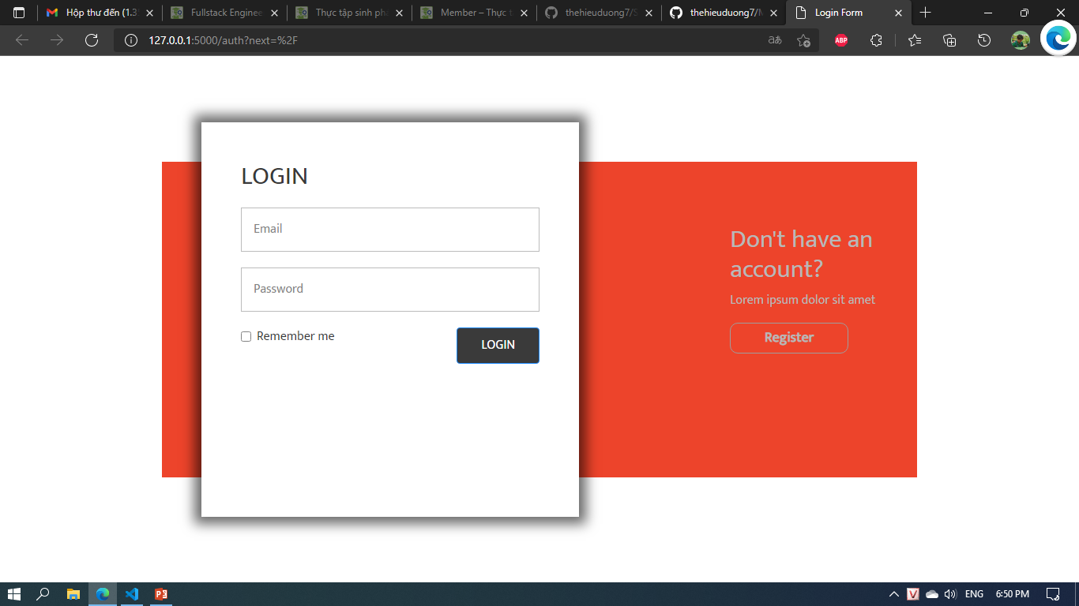
LOGIN

Slide 4
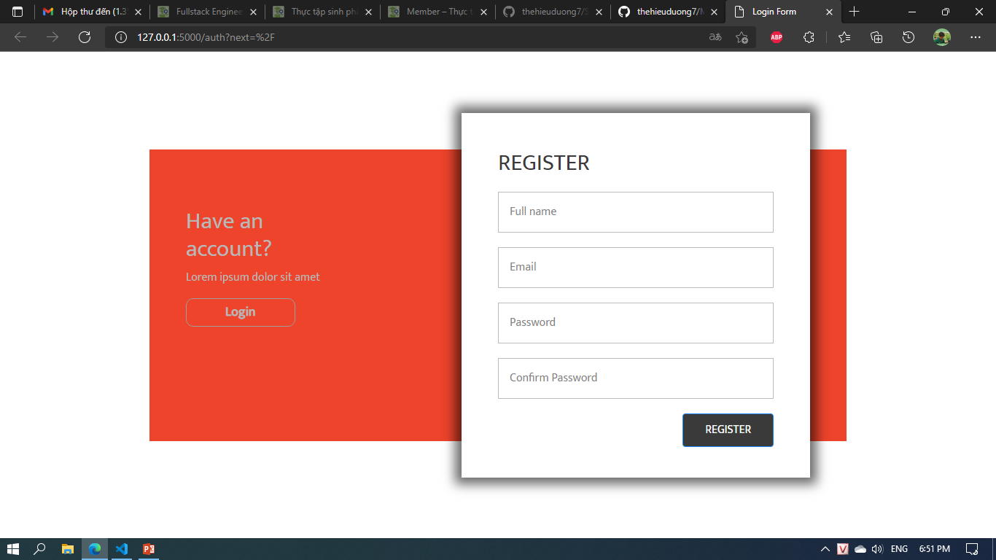
Register

Slide 5
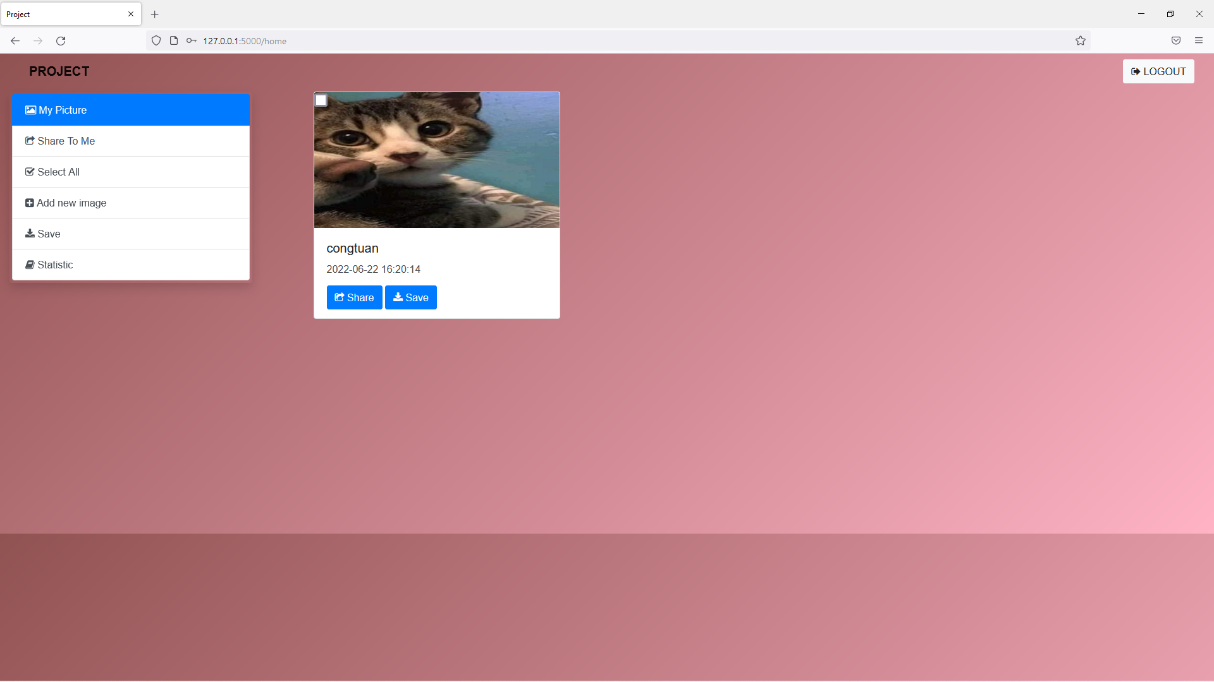
Home
Display list my picture

Slide 6
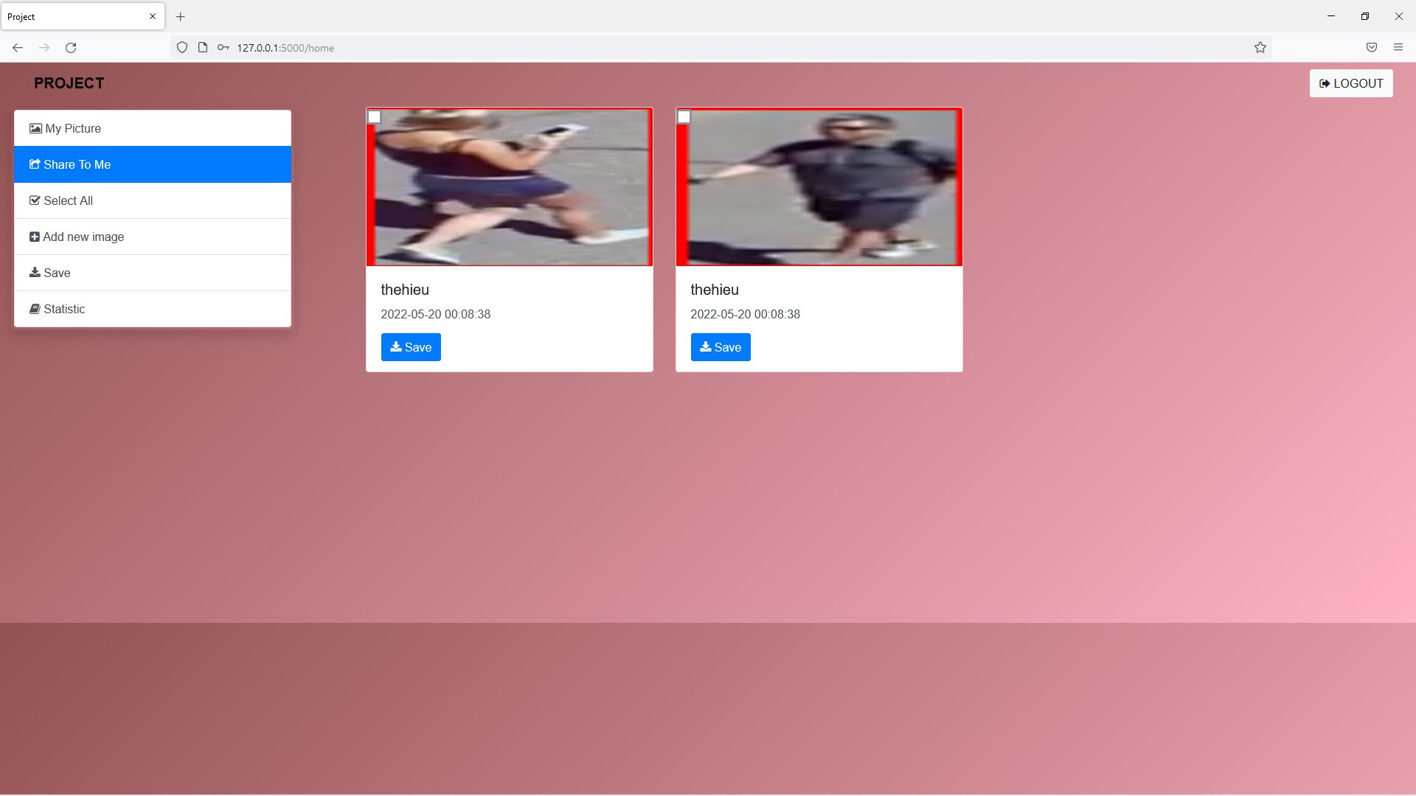
Share to
Display list my picture are shared to me

Slide 7
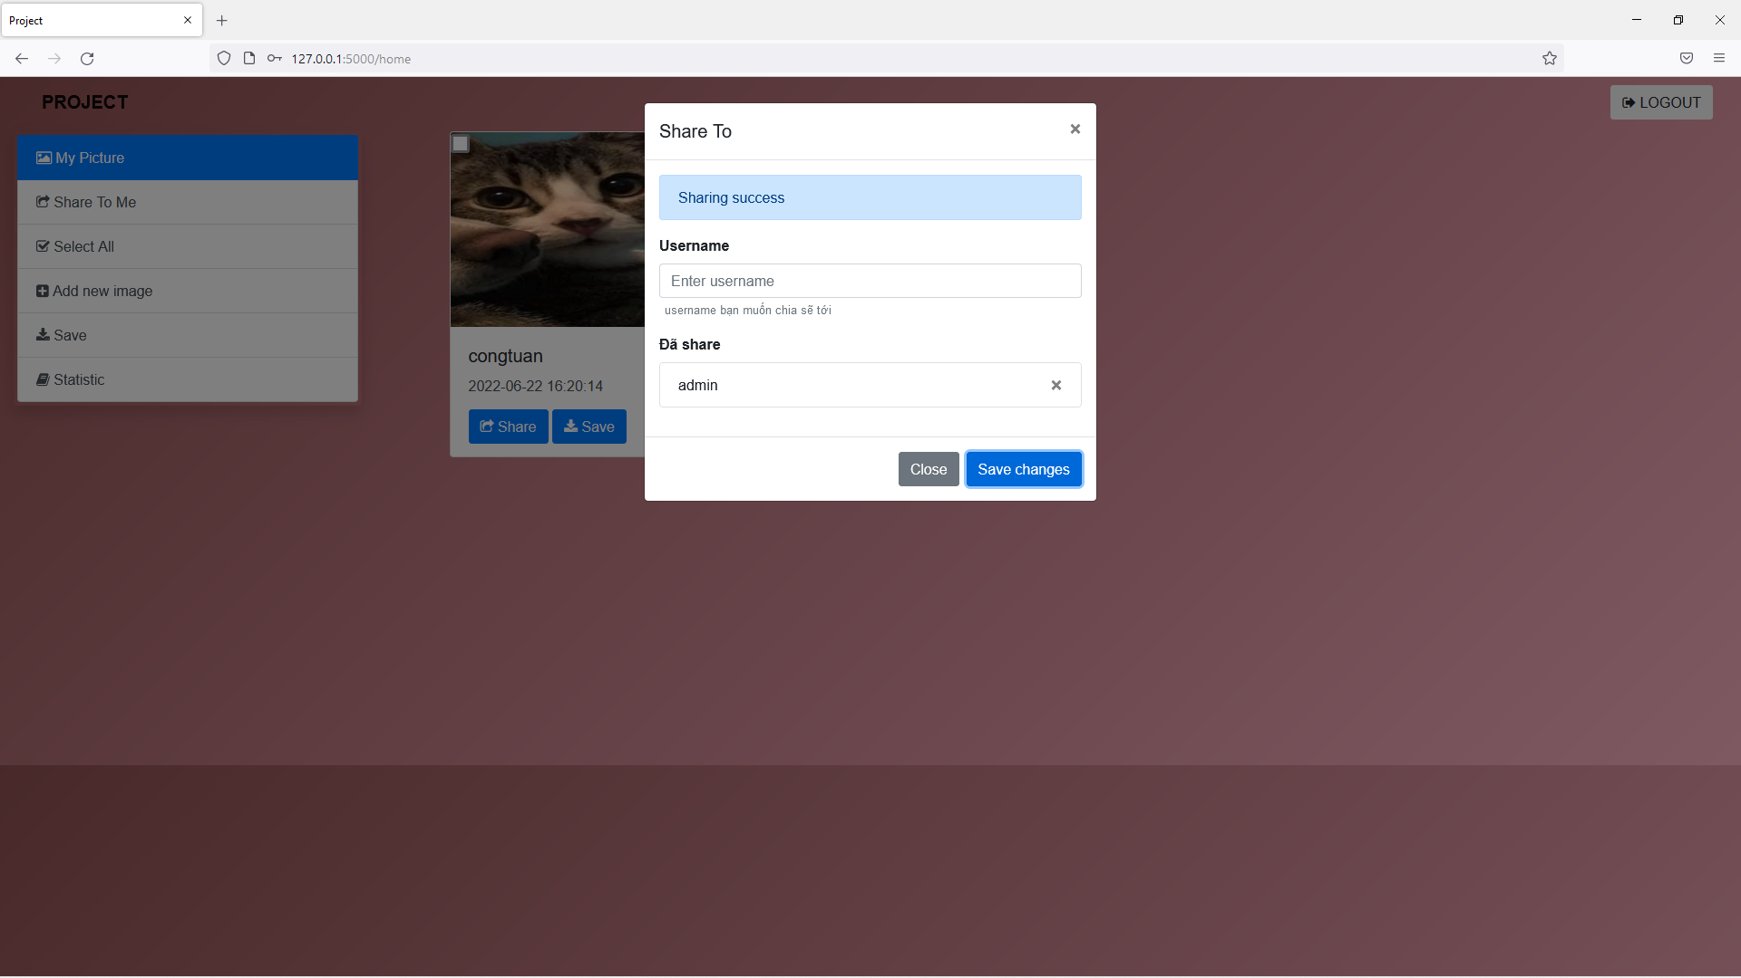
SHAre
Share to another user

Slide 8
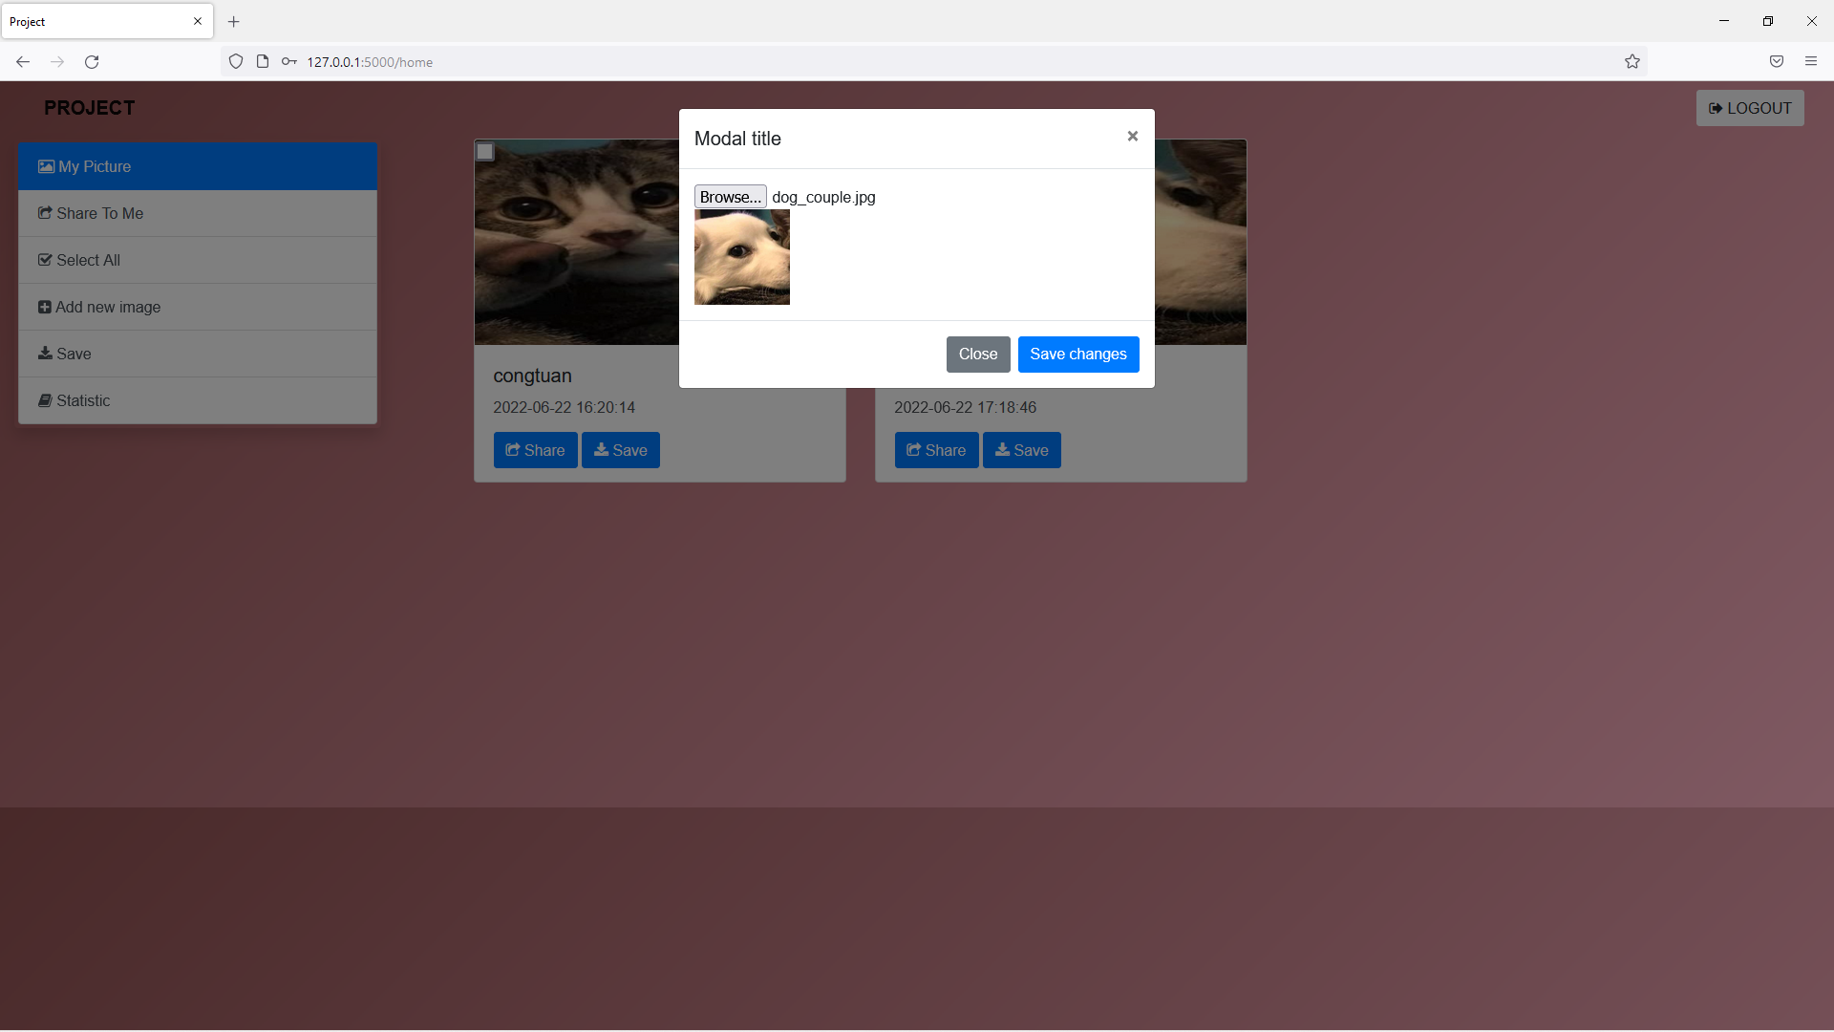
Upload
Upload picture

Slide 9
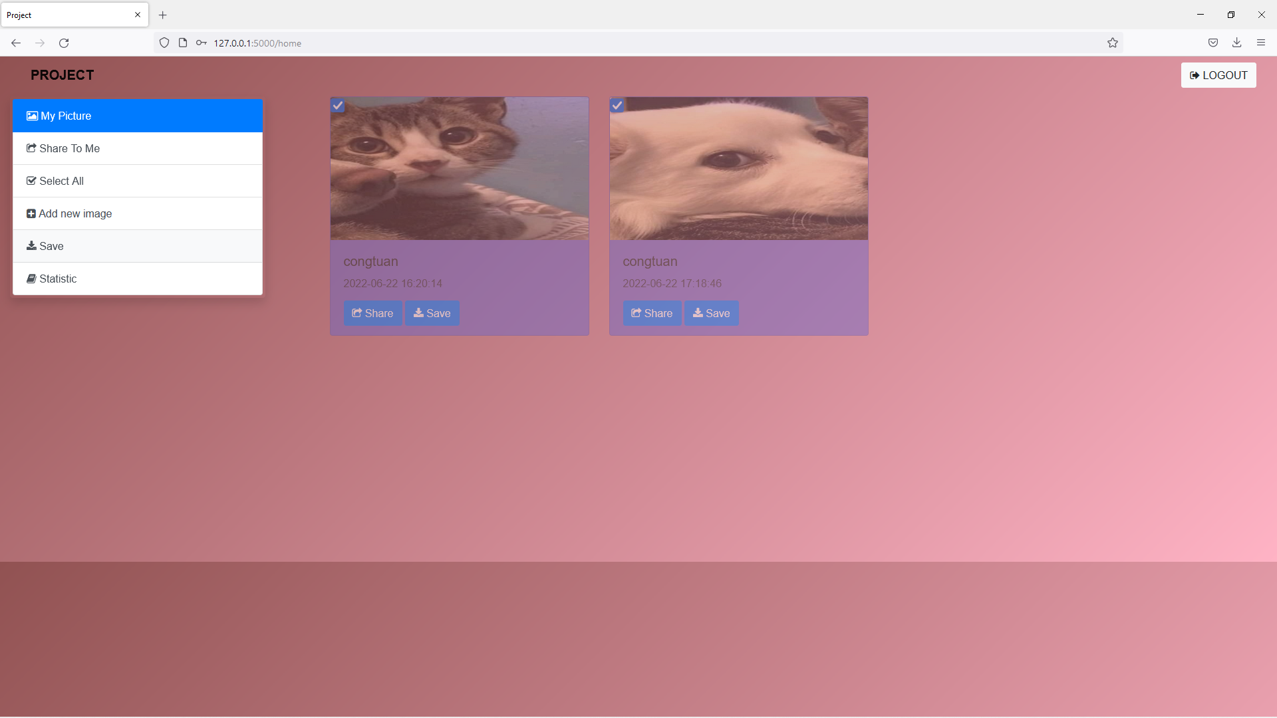
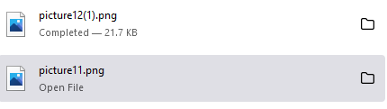
Selected and save

Slide 10
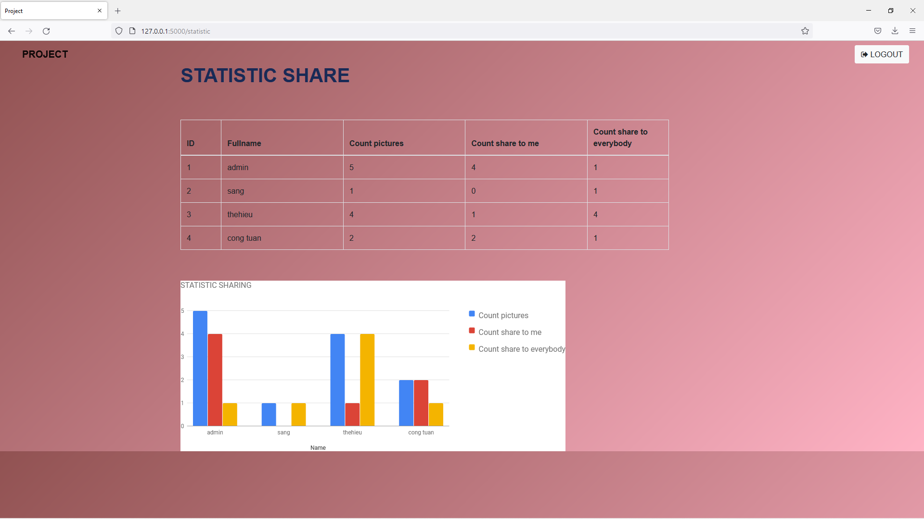
Statistic

